Slide 1
TRIPEM
VASAVI COLLEGE OF ENIGNEERING
TRIP EXPENSE MANAGER

Slide 2
TEAM MEMBERS
M. Teja 1602-21-737-120
Ch. Vignesh 1602-21-737-124
K. Vikas 1602-21-737-125
S. Bharath 1602-21-737-313

Slide 3
ABSTRACT
TRIPEM is an app which can be used by all trip people. The main objective of this app is to assist the users during their trip. The app mainly consists of three objectives , the first objective is to show the current weather conditions of the destination place and the second objective is to track the expenses of the team when they are on their tour , third objective is to show
tourist places and hotels near by.

Slide 4
INTRODUCTION
* The main objective of the project is to manage the trip expenses during a trip and to know weather conditions of the destination place. This project is useful for trip people. It is a GUI based application.
* In this application, at maximum we can enter 5 trip traveler details and we can add their trip expense details i.e. a traveler can enter details for the what purpose he/she spent at specific time and date. We are allowed to track the expenses at any point of time.
* We can know the exact weather conditions like current temperature, humidity, minimum temperature, maximum temperature and graticule location of destination place.

Slide 5
MODULES
*Kivymd for GUI.
*Bs4 module for to know weather conditions
*Requests library to extract specific information.
*Datetime module is imported to work with the date as well as time.

Slide 6
HARDWARE REQUIREMENTS
SOFTWARE REQUIREMENTS
Minimum Ram required: 512 mb
Minimum Disk Space required: 50 mb
Processor: core i3 or above
Input devices: Mouse
Output devices: Monitor
Python 3.9 Latest Build
Windows Desktop version (7/8/10/11)
PyCharm IDE for windows devices
Pydroid3 for Android devices

Slide 7
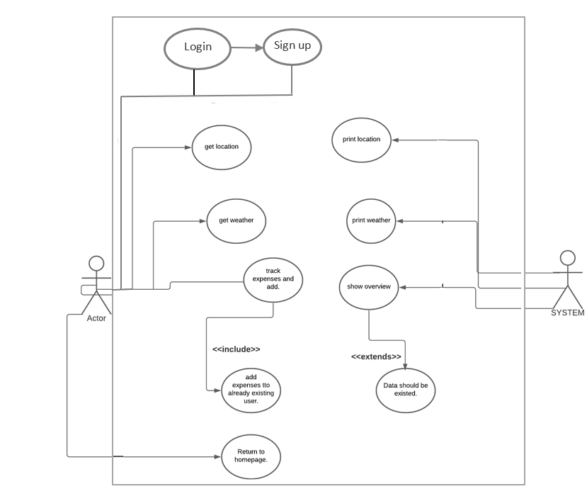
UML DIAGRAM

Slide 8
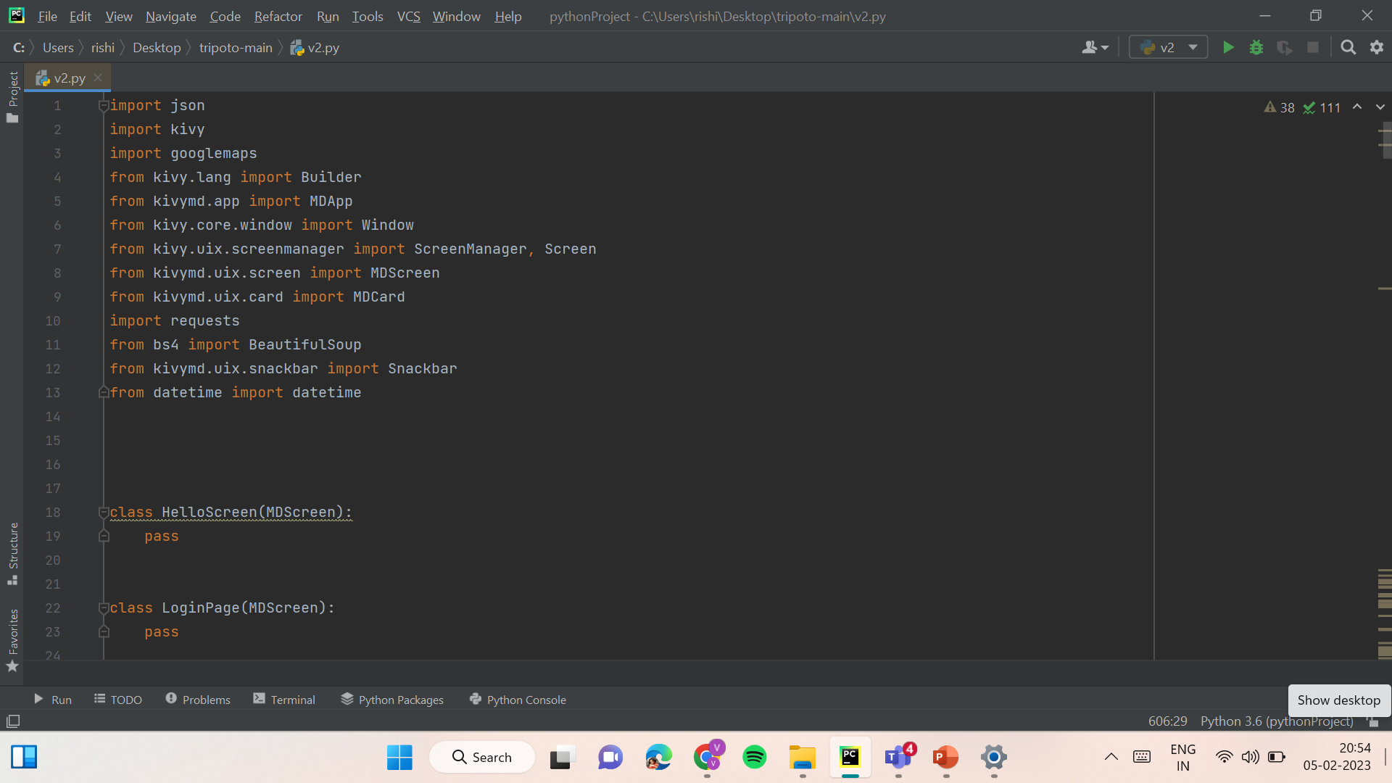
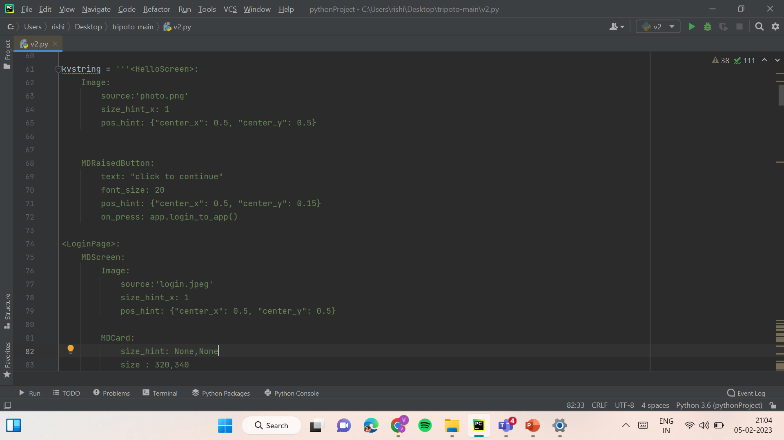
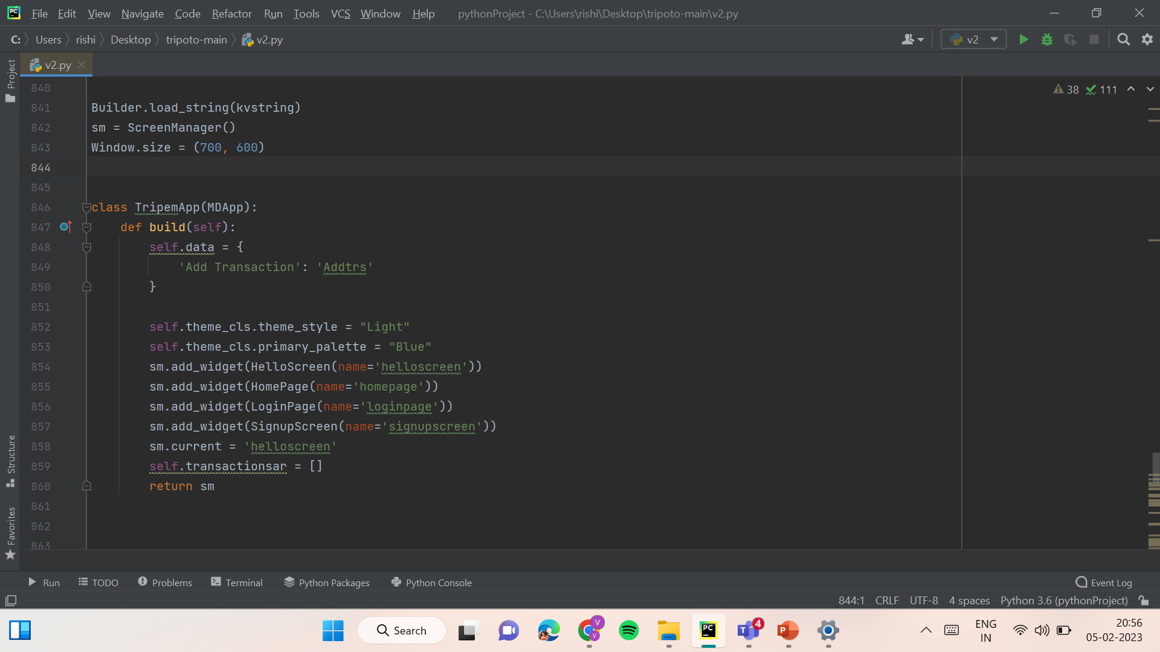
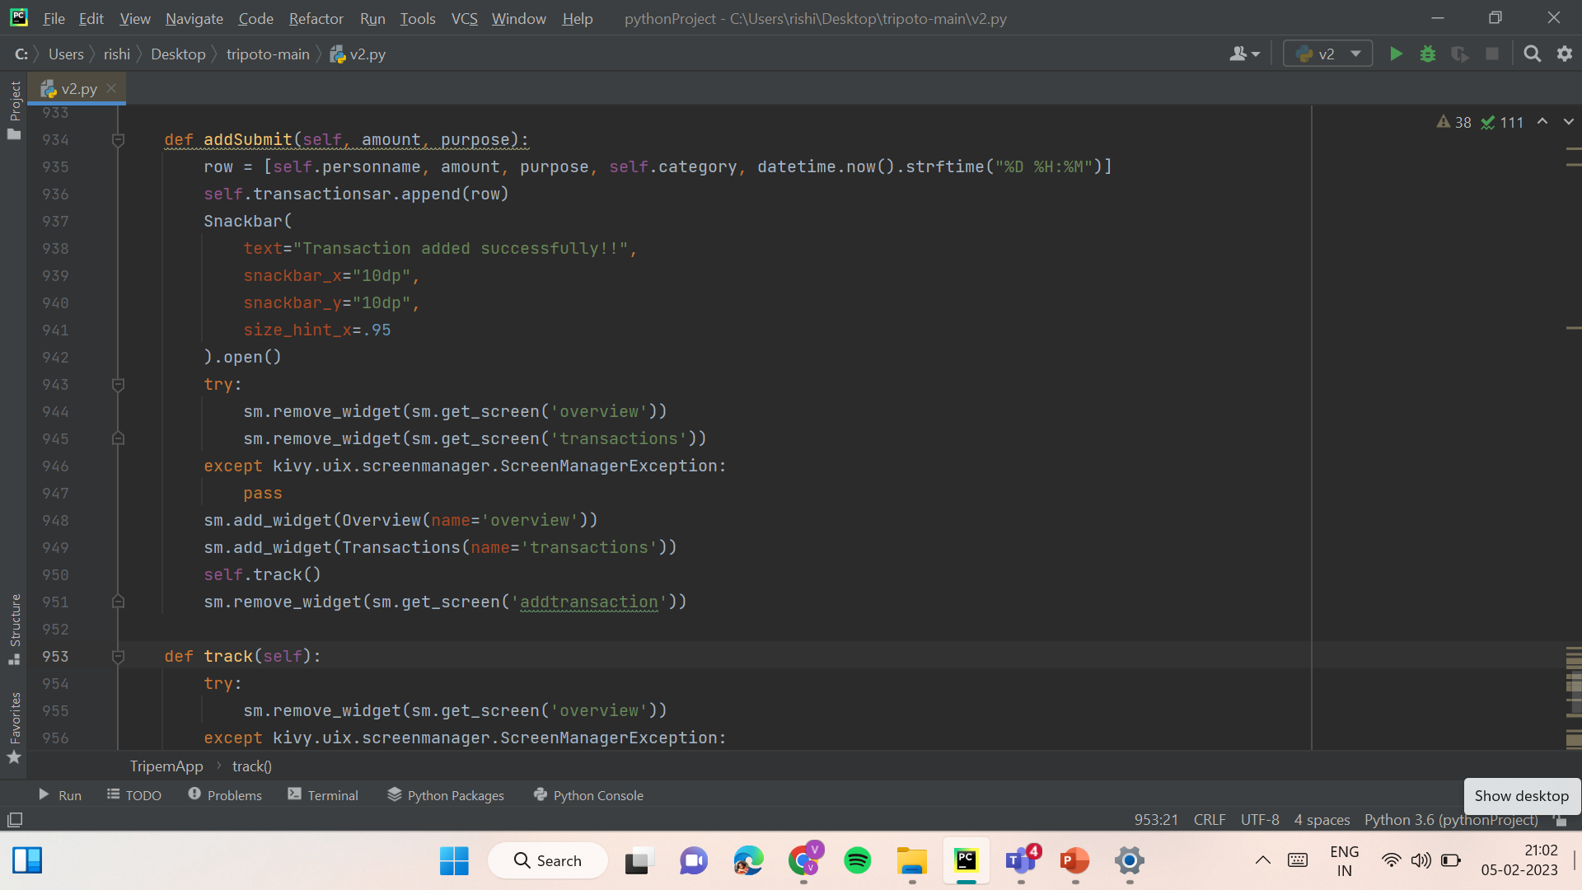
CODE SNIPPETS

Slide 9
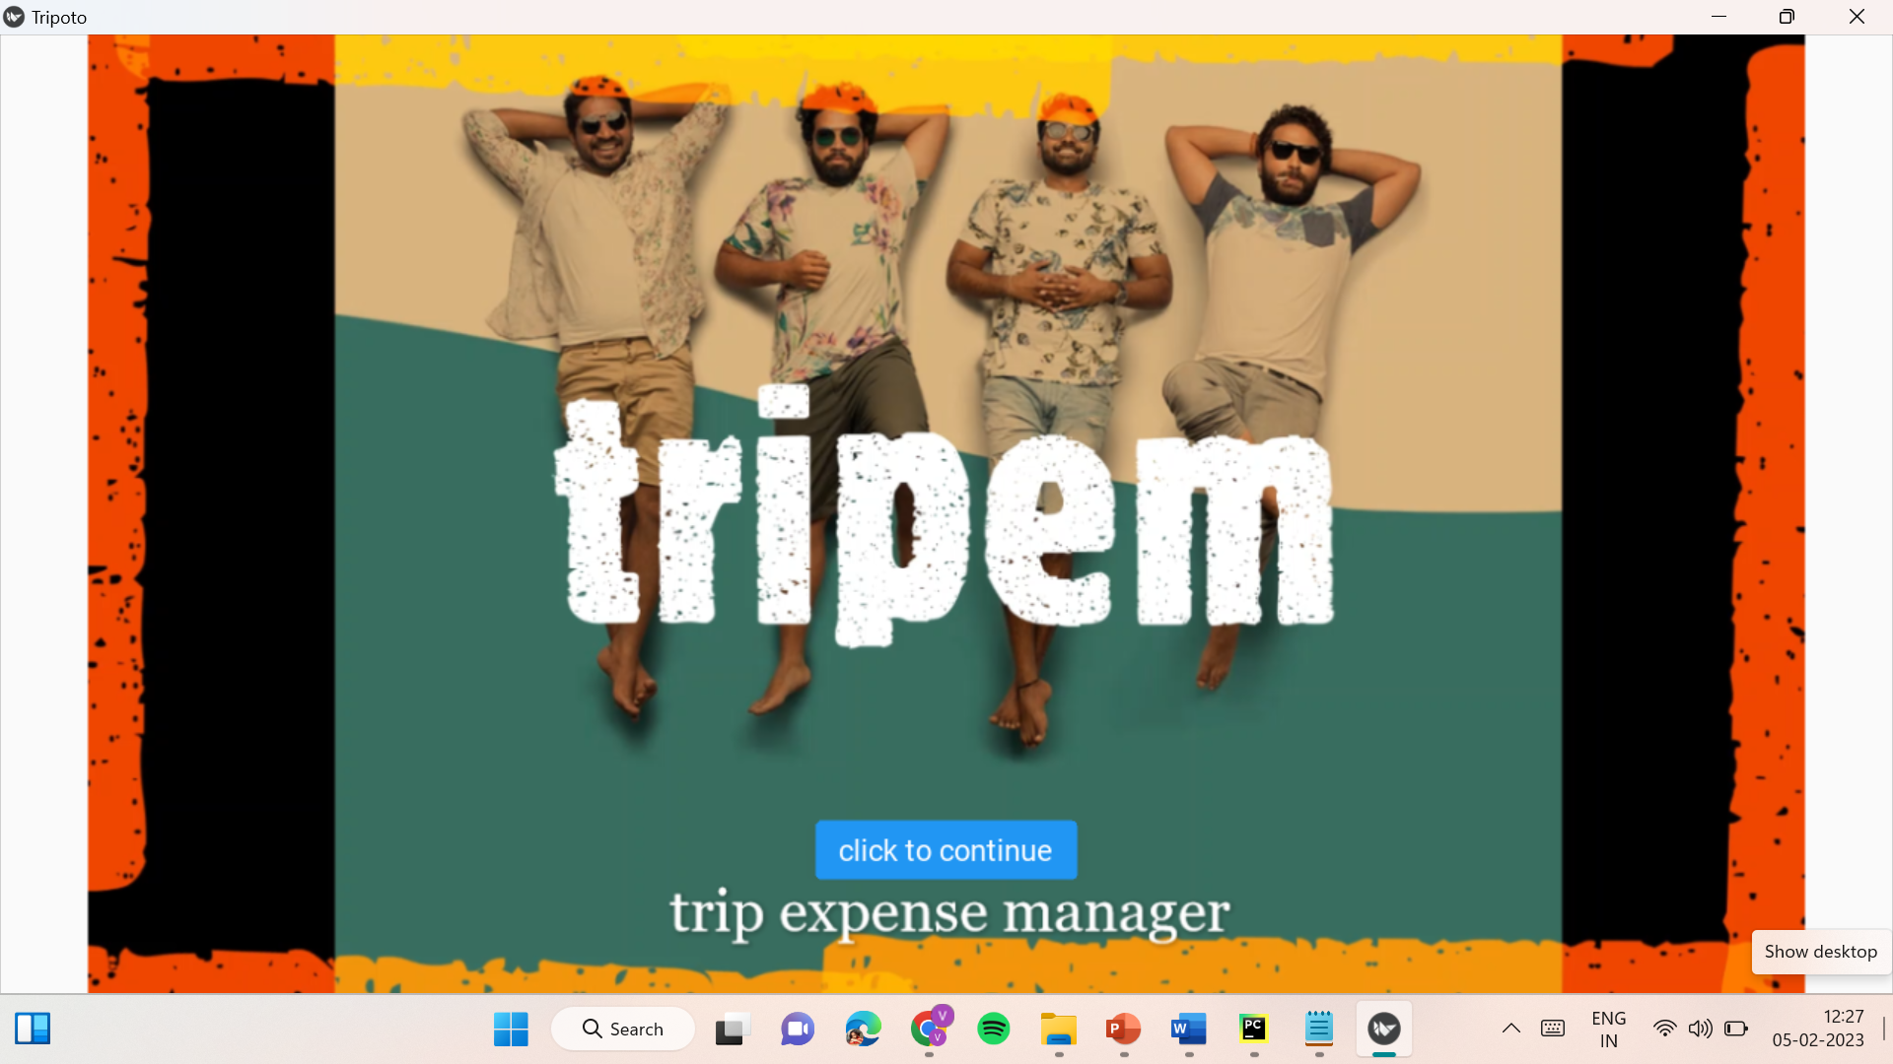
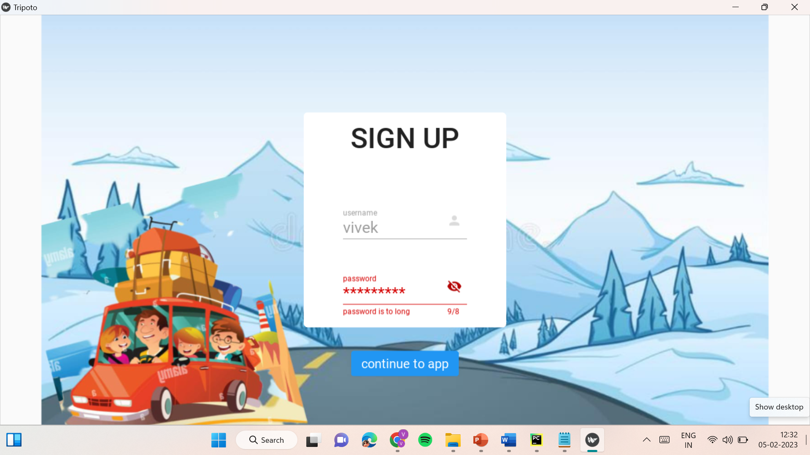

SCREENSHOTS

Slide 10
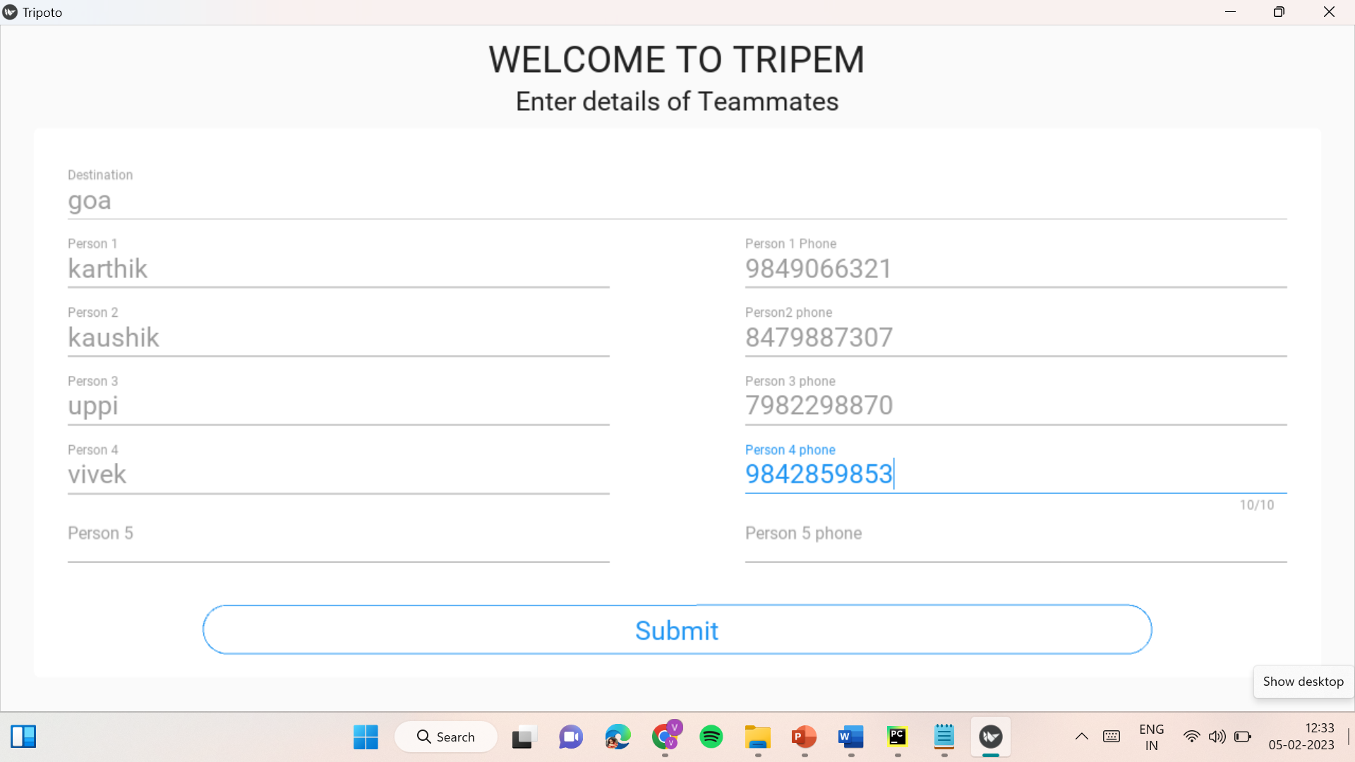
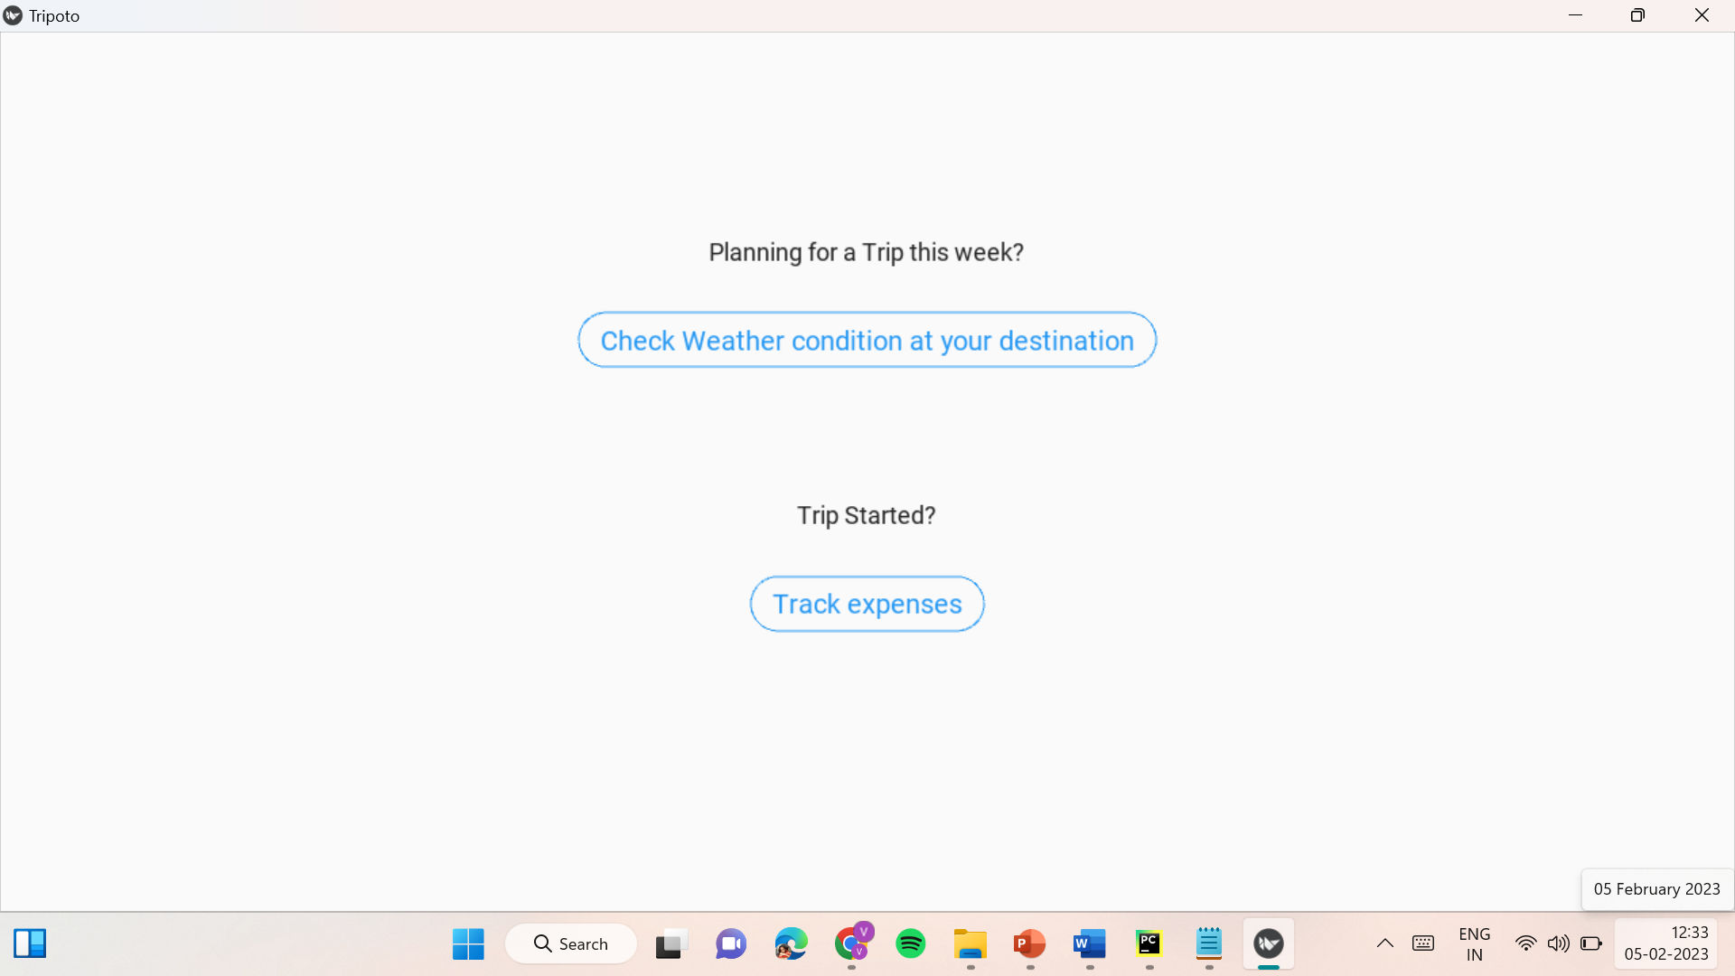
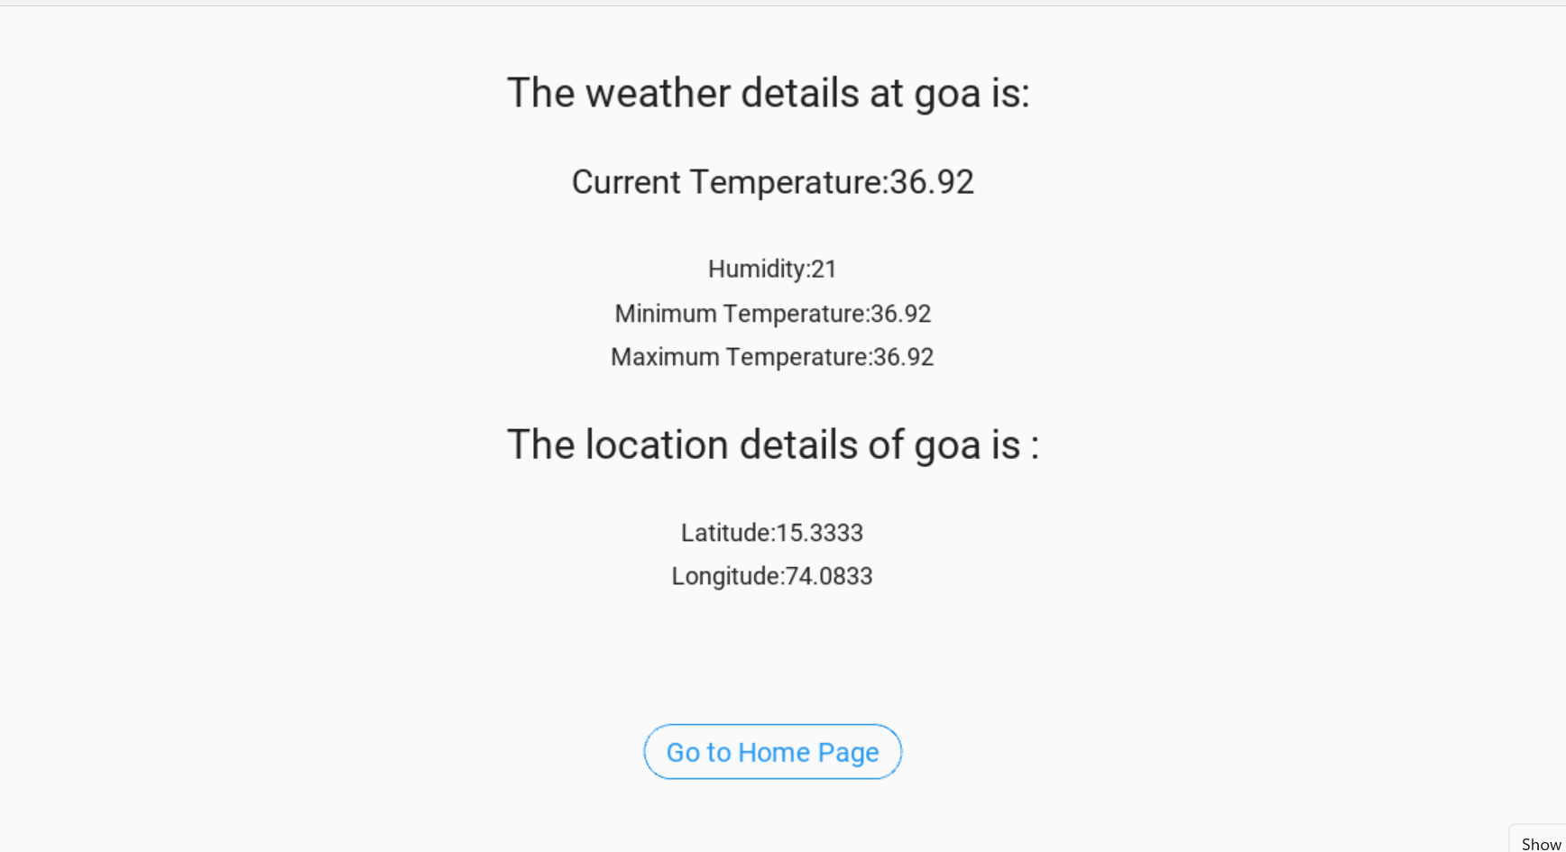
SCREENSHOTS

Slide 11
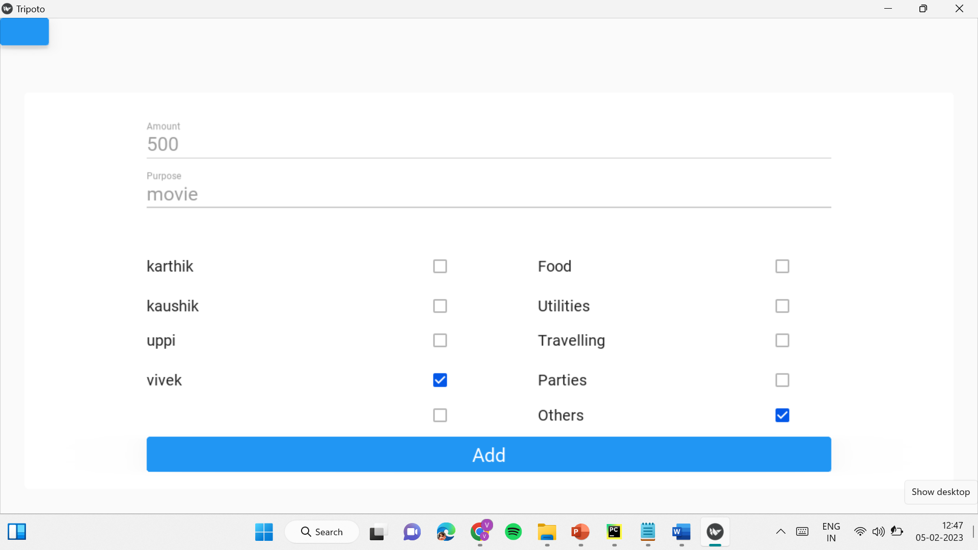
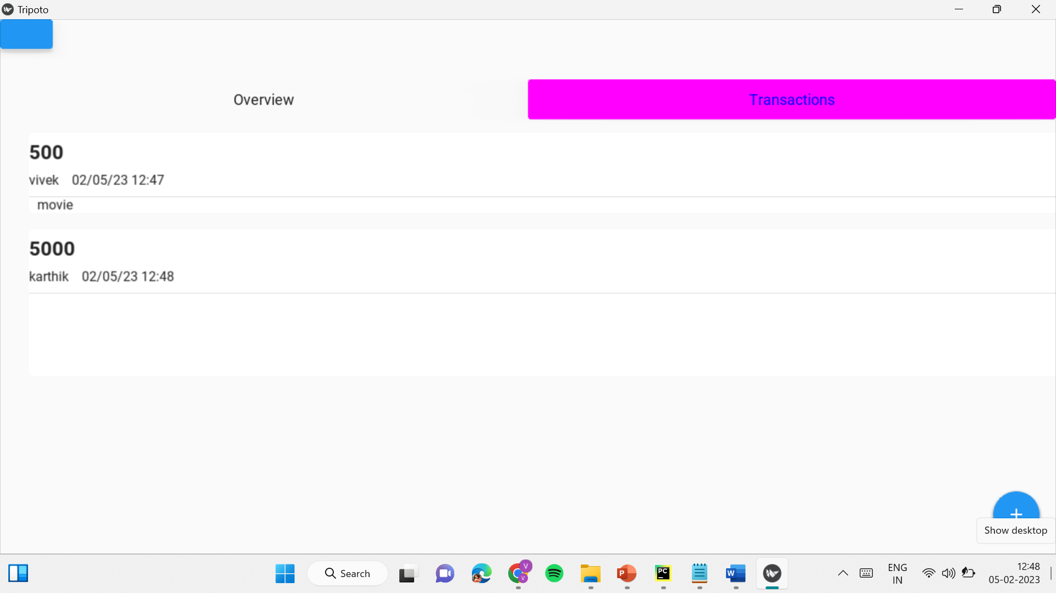
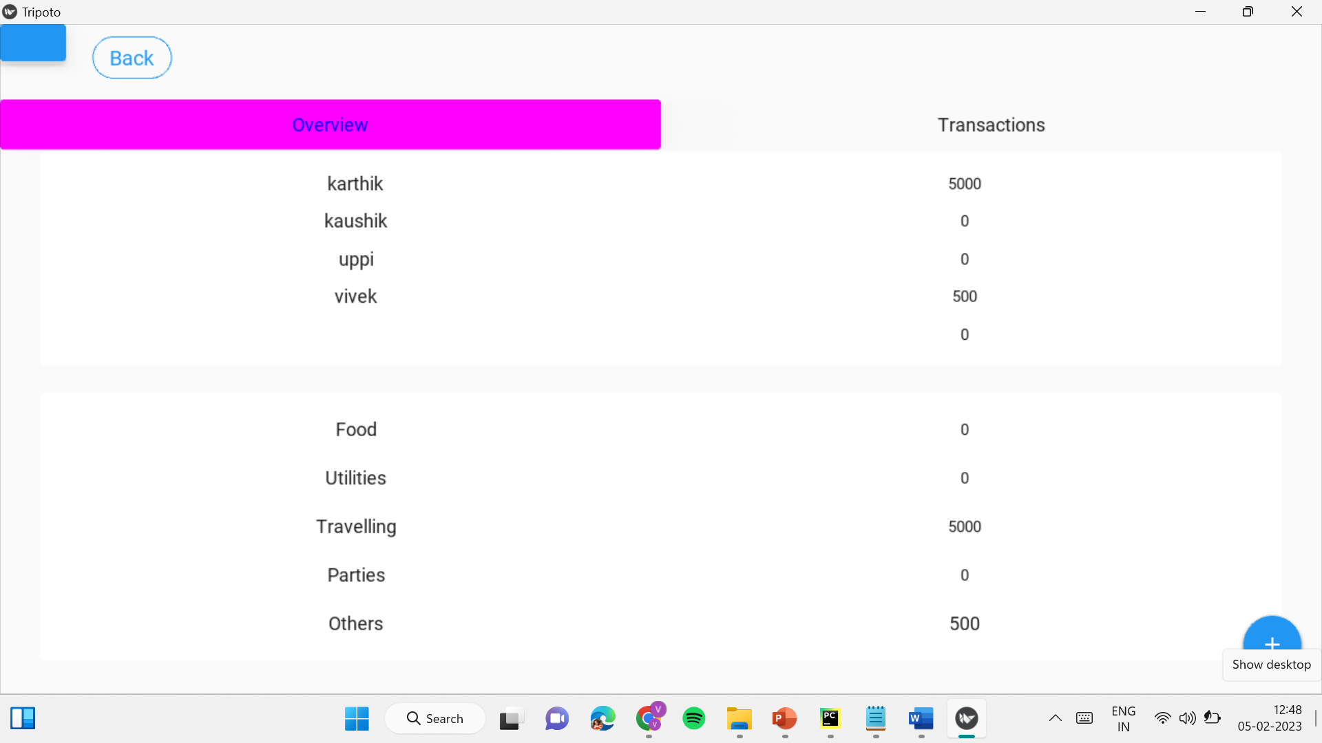
SCREENSHOTS

Slide 12
FUTURE SCOPE
In the coming days, the app can be improvised by adding some more features like:
Integrating maps, it help us know hotels, tourist places near by your location.
Artificial intelligence can be used to show the trends of people travelling and details of average money spent by the travelers.
An option to upload photos, so that every member in the team can upload and download their photos.

Slide 13
CONCLUSION
This project help us to know weather conditions like current temperature, humidity of destination place and expenses spend by each individual person during the trip

Slide 14

THANKS!
Please keep this slide for attribution

